Slide 1



Sports Inventory Application for
GREATER HYDERABAD MUNICIPAL CORPORATION
March 29, 2018

Slide 2

Agenda
Inventory Workflow
Application Prototype

Slide 3
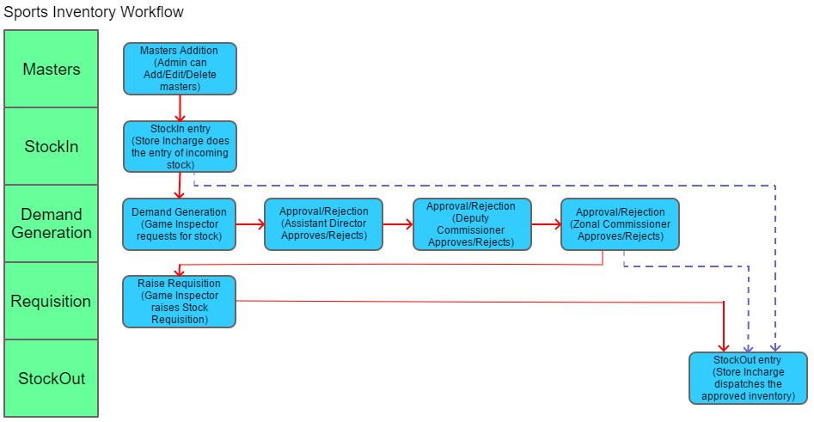

Slide 4
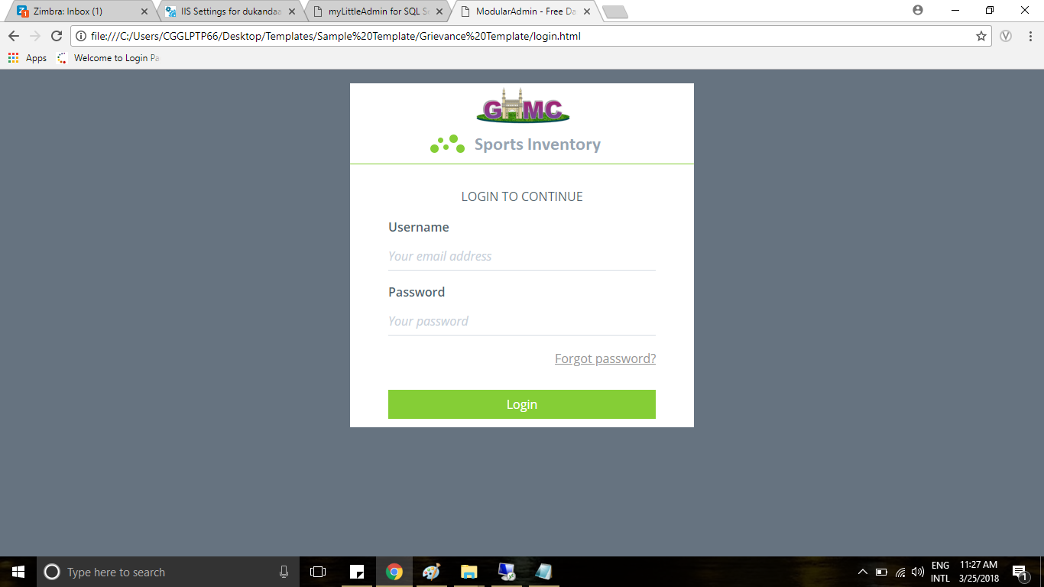

Slide 5
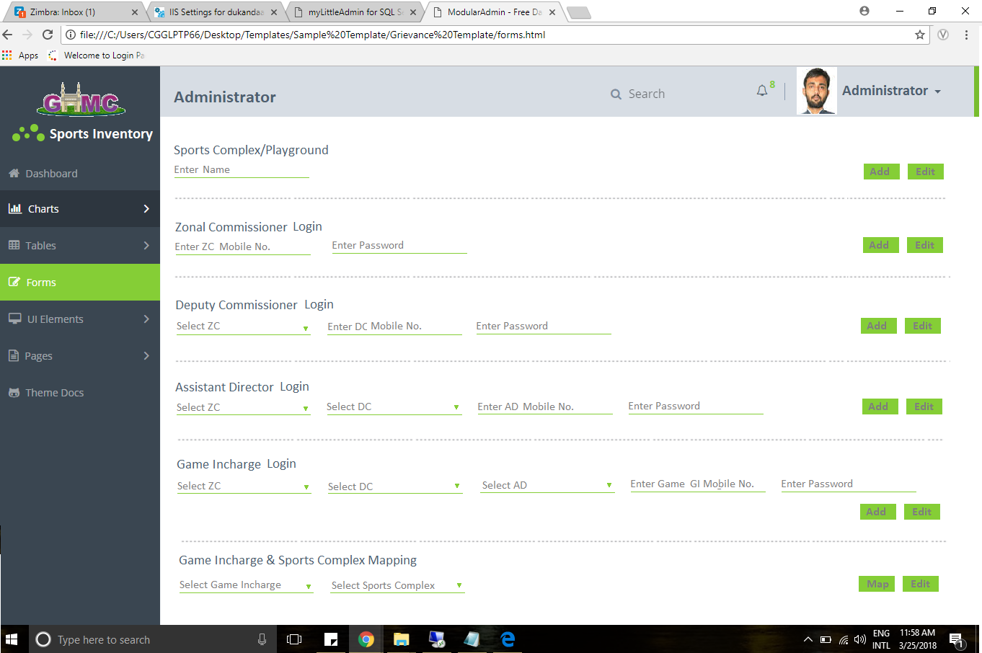

Slide 6
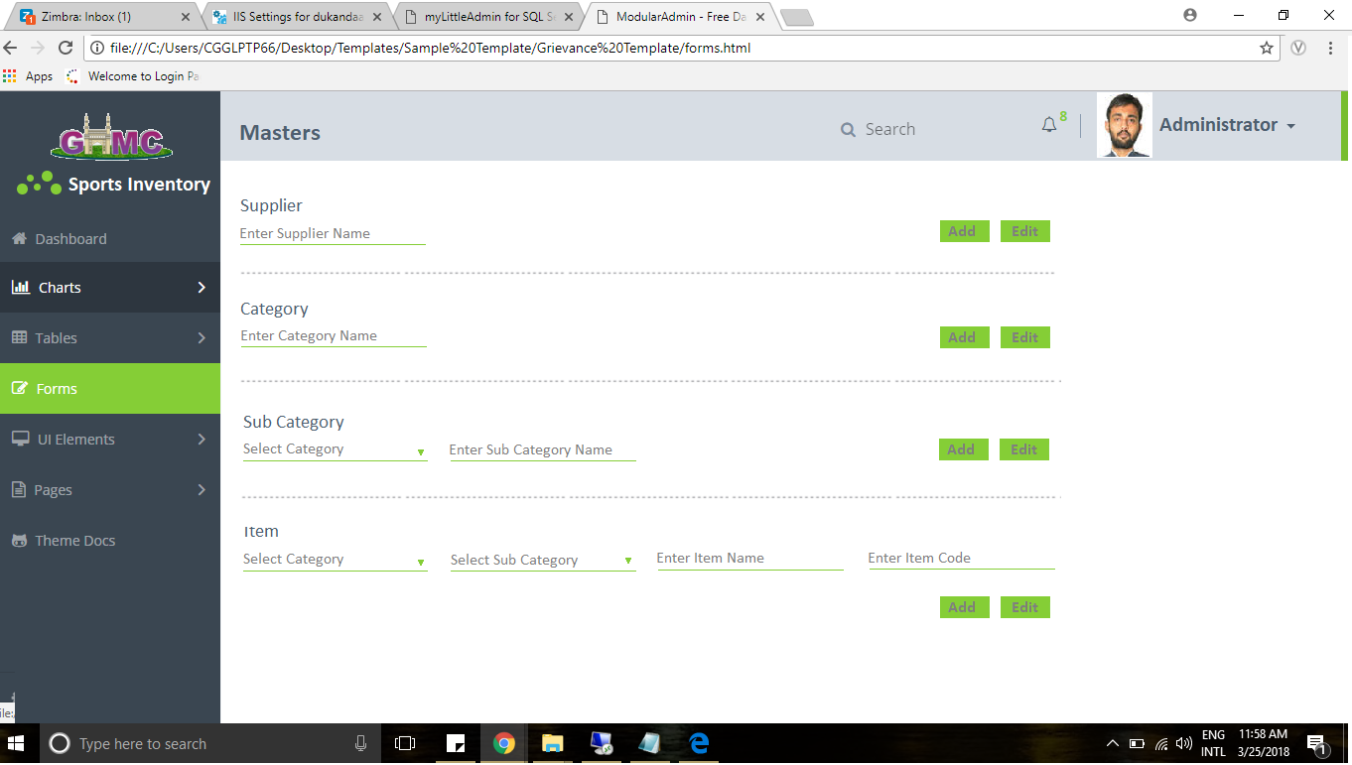

Slide 7
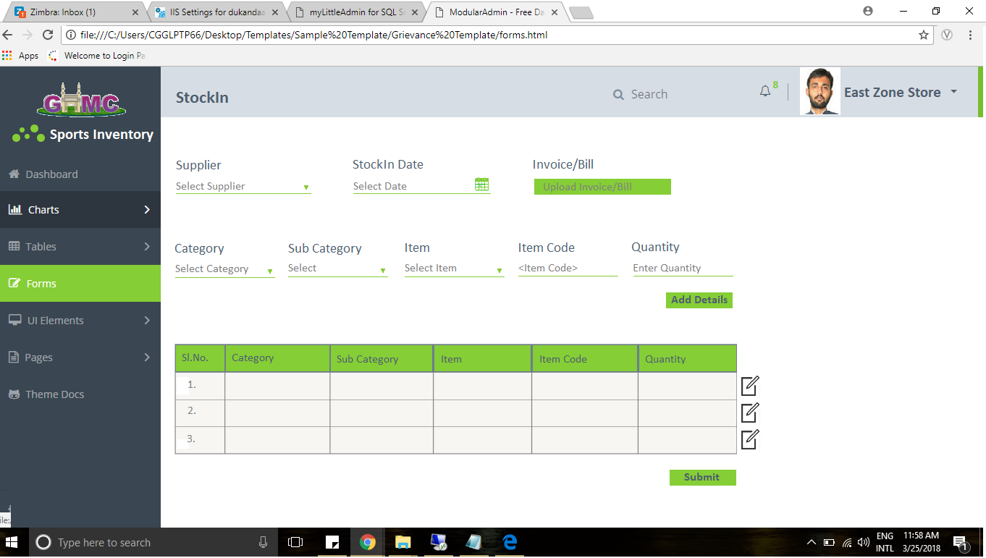

Slide 8
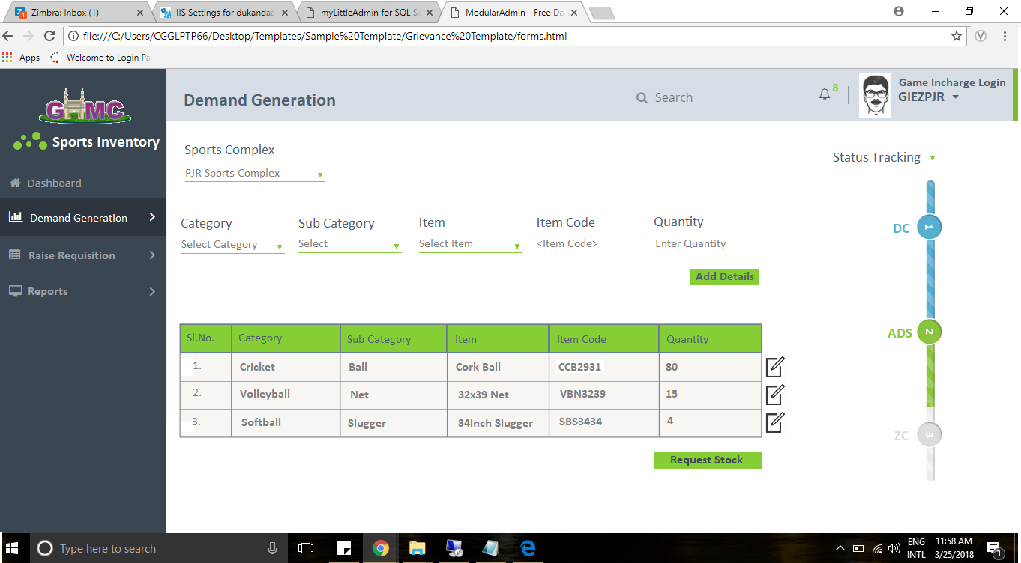

Slide 9
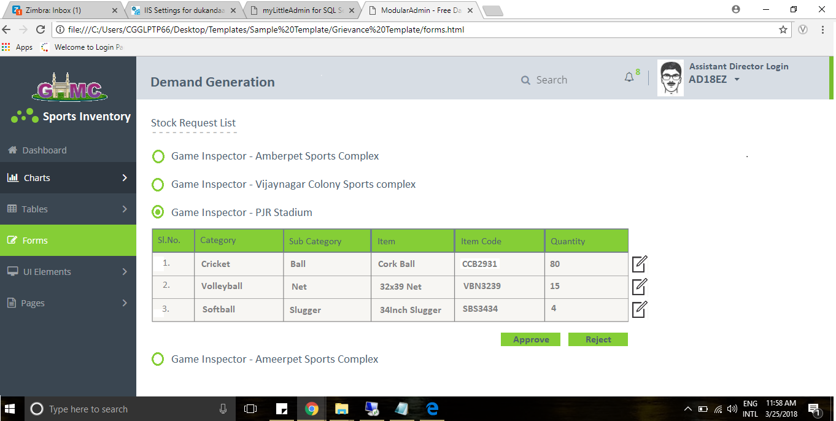

Slide 10
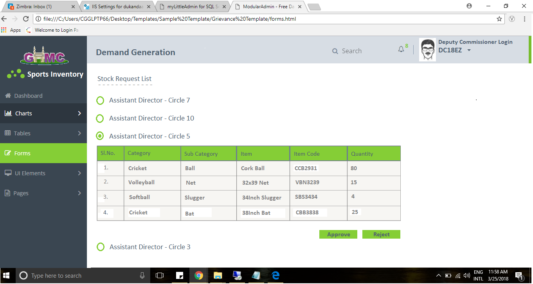

Slide 11
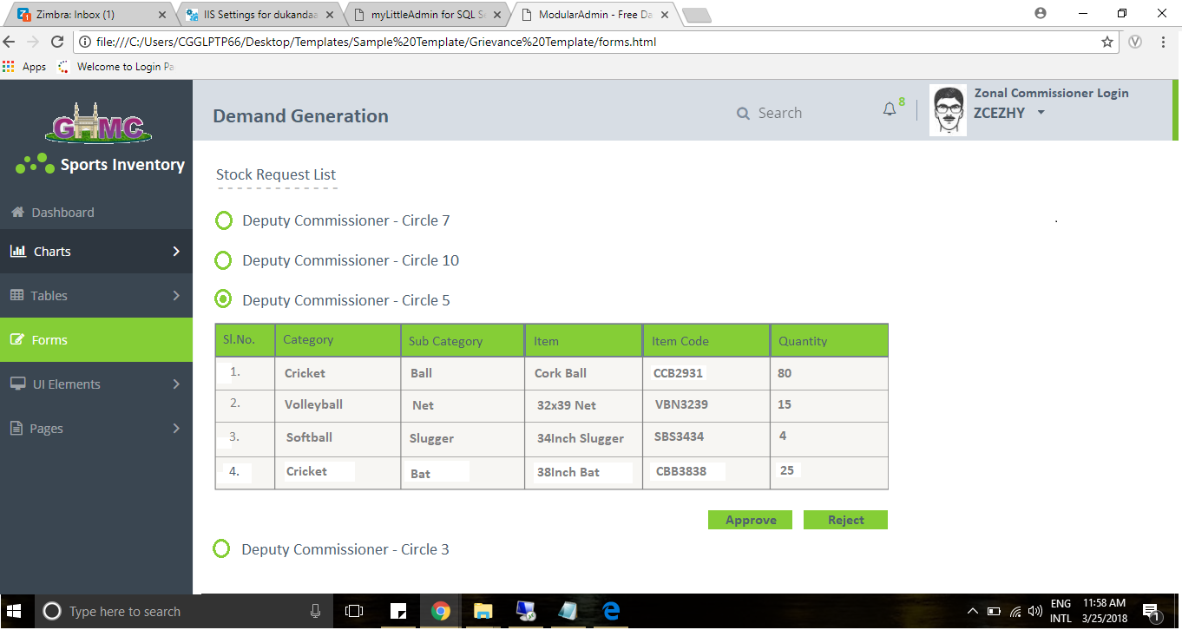

Slide 12
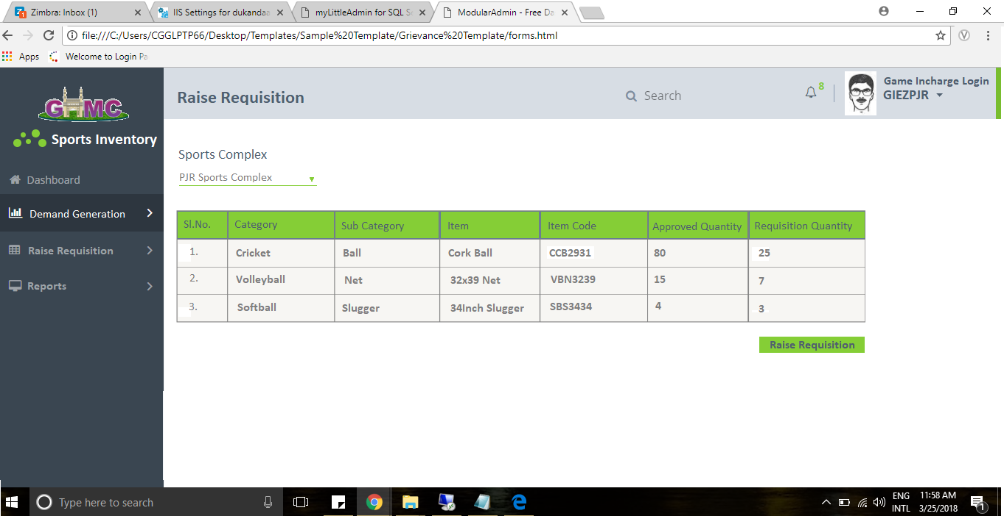

Slide 13
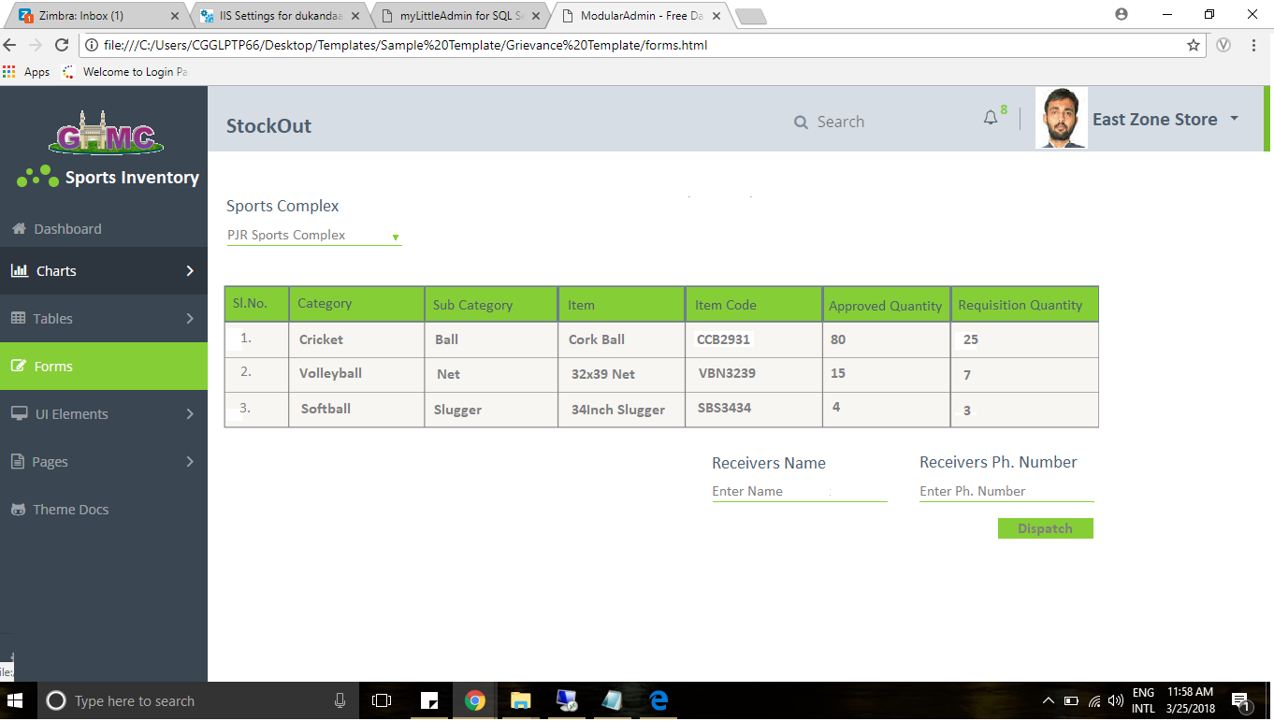

Slide 14
Thank You
Jubilee Hills Campus:
Centre for Good Governance (Dr. MCR HRD Institute Campus), Road No. 25, Jubilee Hills, Hyderabad 500033 Telangana, India.
contact info
Phone: +91 40 2354 1907 / 09, 23686000 Fax: +91 40 2354 1953 Email: email : info@cgg.gov.in
Gachibowli Campus:
Centre for Good Governance Survey No. 91, Near Outer Ring Road Chowrasta, Gachibowli, Hyderabad 500 032, Telangana, India.
contact info
Phone: +91 40 2312 0009 Fax: +91 40 2300 1777 Email: email : info@cgg.gov.in

